Slide 1
Beer and Brewery
Tadd Backus & Austin Webb
June 14, 2022

Slide 2
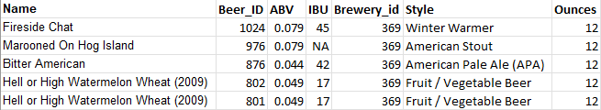
What is the Data?
Beer Dataset:
2,410 rows and 7 columns
Name: Name of the beer
Beer_ID: Unique identifier of the beer
ABV: Alcoholic by volume of the beer
IBU: International bitterness units of the beer
Brewery_ID: Brewery id associated with the beer
Style: Style of the beer
Ounces: Ounces of beer

Slide 3
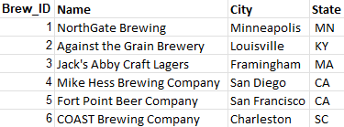
What is the Data?
Brewery Dataset:
558 rows and 4 columns
Brew_id: Unique identifiers of the brewery
Name: Name of the brewery
City: City where the brewery is located
State: U.S. state where the brewery is located

Slide 4
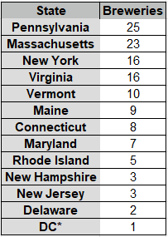
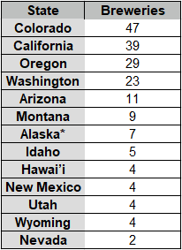
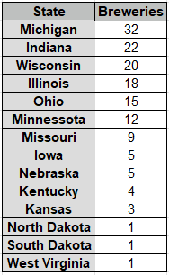
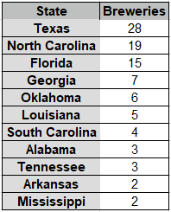
How Many Breweries in Each State

Slide 5
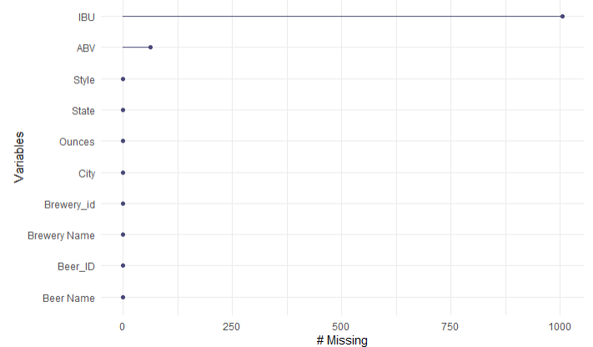
Address the Missing Values
ABV has 62 missing values (2.57%)
IBV has 1005 missing values (41.70%)
Deleted the observations with missing values

Slide 6
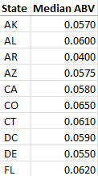
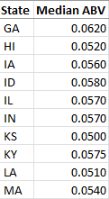
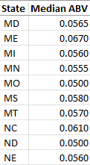
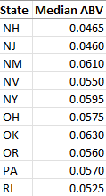
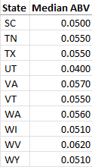
Median ABV for Each State
We can see the median ABV for each state

Slide 7
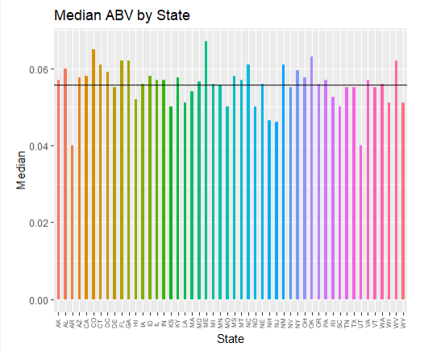
Median ABV for Each State
We can visually see how each state’s median ABV compares to each other
Horizontal line is the mean (0.05564)

Slide 8
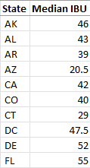
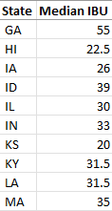
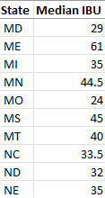
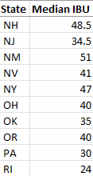
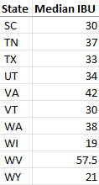
Median IBU for Each State
We can see the median IBU for each state

Slide 9
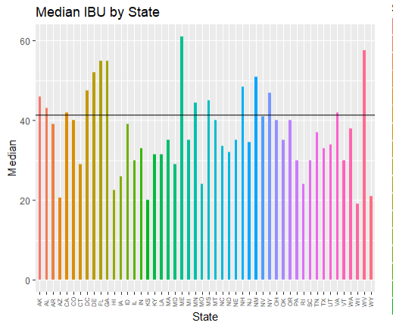
Median IBU for Each State
We can visually see how each state’s median IBU compares to each other
Horizontal line is the mean (41.4151)

Slide 10
Max ABV
We searched the database and extracted this row
Max ABV is found in Louisville, Kentucky
Max ABV is 0.125

Slide 11
Max IBU
We searched the database and extracted this row
Max IBU is found in Astoria, Oregon
Max IBU is 138

Slide 12
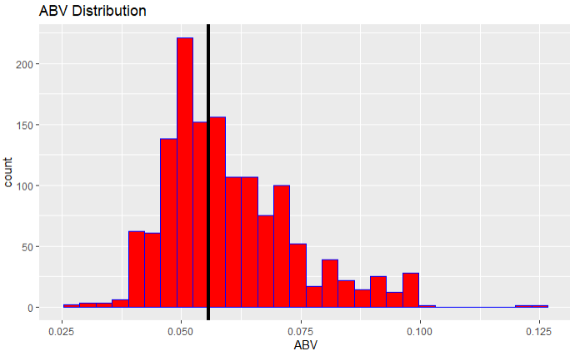
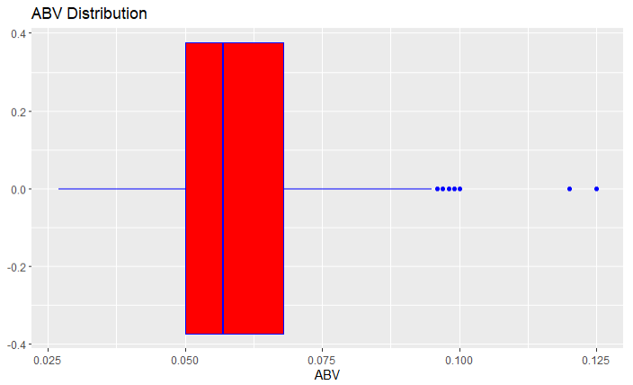
ABV Statistics
Minimum: 0.027
1st Quarter: 0.05
Median: 0.057
Mean: 0.05991
3rd Quarter: 0.068
Max: 0.125

Slide 13
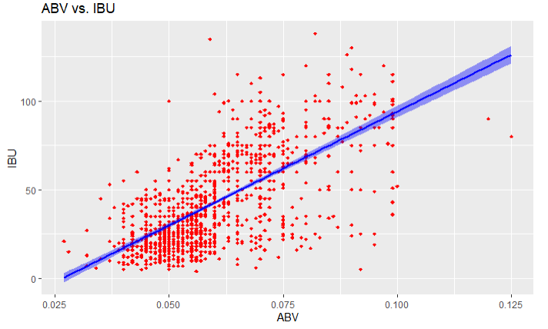
Relationship Between ABV and IBU
The correlation coefficient is 0.6706
This suggests that ABV and IBU moderately influence the other. As one increases, the other also increases.

Slide 14
Future of the Project
We would like to further our investigation and identify the difference with respect to ABV and IBU between IPAs and other ales.
We also conducted all the previous tests and plots with the missing values imputed as the mean of those columns.
We would like to see if there is significant difference between the ways we deal with the missing values.

Slide 15
Contact Info
Tadd Backus
tbackus@mail.smu.edu
Austin Webb
austinwebb@mail.smu.edu

